Slide 1
GLA London Community Resilience Toolkit
Kingston VCSE Forum
Wednesday 26th June 2024

Slide 2
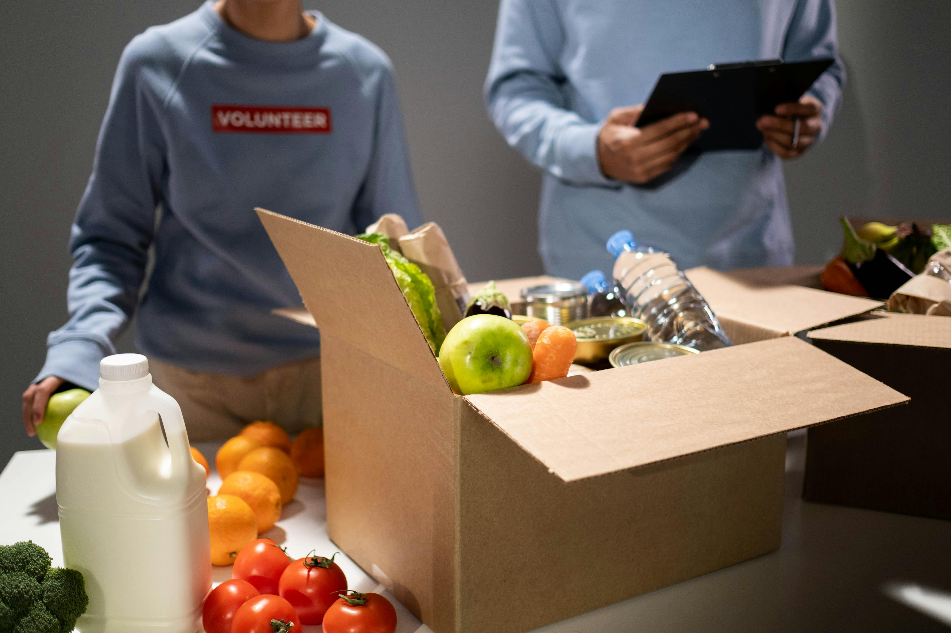
About this project
Photos
Notes:
Volunteering Kingston
Communities Prepared
Kingston specific toolkit – compliment
Photos
2 mins

Slide 3
Our Brief
A toolkit to support London communities, in the context of increasing climate incidents and emergencies
A practical document, with information, guidance, tools to support community resilience activities
Accessible language, avoiding jargon and focusing on strength and asset-based community development
Content tested and developed with communities
Notes:
We know that climate challenges and emergencies are likely to increase in the future, such as floods or heatwaves.
We are creating a toolkit to support the development of community resilience
Bringing together practical guidance, support, templates to communities in an accessible and digestible way
To support the work already taking place, to help bring together community resilience activities
We want to make sure the toolkit is right for you and your communities, so it would be great to get your insights and inputs so we can incorporate and adapt the toolkit to meet your needs.
Important that we reach all the diverse range of community, voluntary, faith and social equality groups, to ensure that we are including and representing the whole of London
2 mins

Slide 4
Toolkit Overview
Part 1:
Part 2:
Part 3:
Part 4:
Part 5:
Community Resilience Hubs
Climate Resilience
Community Mapping
Introducing the Toolkit
Skills & Capabilities
an overview on EDI/ wellbeing
Community Emergency planning
Hazards
volunteering in an emergency
WIP – Still in development
Notes:
We are still in the early stages of content development, but wanted to give you an initial overview of the types of topics we will be including
Understanding community resilience: A breakdown of what is meant by community resilience, why it is important and how it can be fostered.
Community Mapping: Looking at needs, strengths, challenges, risks and resources.
Community Emergency Planning: how a community can plan for an emergency, looking at developing and testing your plan, communication methods and activation
Community Emergency Volunteering: different types of volunteers, their roles and responsibilities, best practice on recruiting and managing volunteers and how they can support community resilience.
Role of resilience spaces (warm spaces in cold weather and cool spaces during heatwaves): A focused look at resilience spaces, such as warm and cool spaces and rest centres, community resilience hubs looking at what’s available, how they can be used and the benefits they bring.
Developing skills and capabilities: Focus on specific skills and capabilities such as communication, engagement methods, relationship building, to support the development of community resilience.
Included throughout the toolkit there will also be: Climate Hazard overviews (Flood and Heat), Templates and activities, Equity, diversity and inclusion considerations
We want to hear from you and your community on what you would like to see in the toolkit and give you an opportunity to test and adapt the toolkit, by taking part in its development

Slide 5
Toolkit Overview
Part 1:
Part 2:
Part 3:
Part 4:
Part 5:
Community Resilience Hubs
Climate Resilience
Community Mapping
Introducing the Toolkit
Skills & Capabilities
an overview on EDI/ wellbeing
Community Emergency planning
Hazards
volunteering in an emergency
WIP – Still in development
Notes:
Today we're going to focus on community mapping - which will then feed into thinking about Community Emergency Planning and Hazards

Slide 6
Emergency Management Cycle
Notes:
What is happening in Kingston?
How best do you map what is going on, why it is going on and where next?

Slide 7
Community Mapping
What do we have in our community?
Who/what/where/when?
Tangible and intangible?
Feeds into the Community Emergency Plan
Strengths/Positive approach
Then turn over the identify the gaps and challenges
Notes:
What is happening in Kingston?
How best do you map what is going on, why it is going on and where next?
This is something you can do in your own organisations, and with your own groups.
Doing this as a group, but feel free to think specifically as your organisation as well as broader.
This is brainstorming – so put down what you can and don't worry about getting it wrong 10 mins 1 side, 10 mins the other

Slide 8
Any questions and thoughts and feedback?
Notes:
Cliff and Emily, Great to hear your reflections and visions for this project?

Slide 9
Contact Us!
Alice, Mike and Molly
Shared inbox for the toolkit development
Londonresilience@groundwork.org.uk / Molly.Sweeney@groundwork.org.uk

Slide 10
Thank you

